Slide 1
HTML Form vs Java Form
MUHAMAD SHOLIHIN

Slide 2
PURE OO HYBRID OO
A language is called PURE object oriented if It contains only objects and classes. In it we do access everything through 'Message Passing'. A Pure Object Oriented Language has these following characteristics, along with four basic characteristics of Object Oriented Programming.
All predefined DATA Types are objects.
All user defined DATA Types are objects.
Data Hiding
Encapsulation
Inheritance
Polymorphism
Abstraction

Slide 3
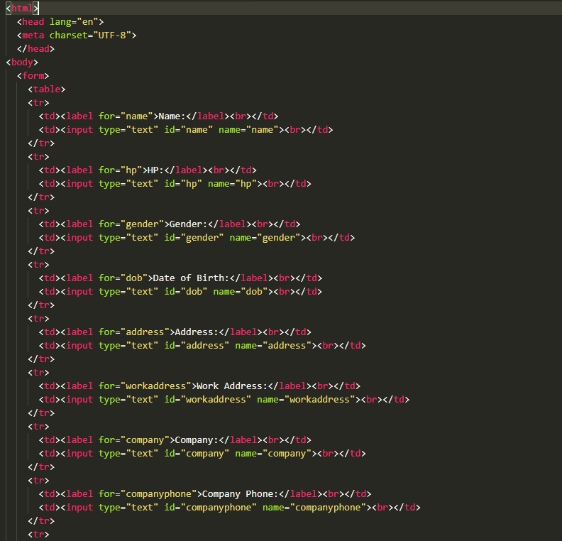
Source Code pekerja.html

Slide 4
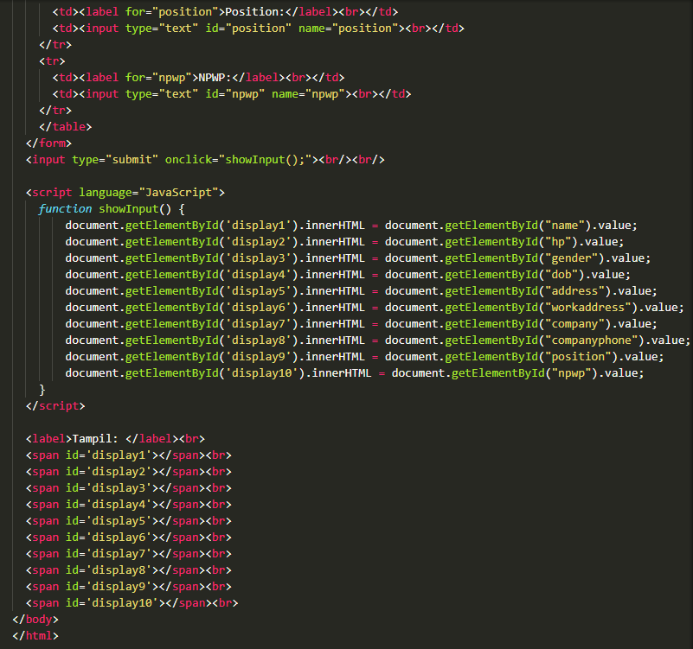
Source Code pekerja.html

Slide 5
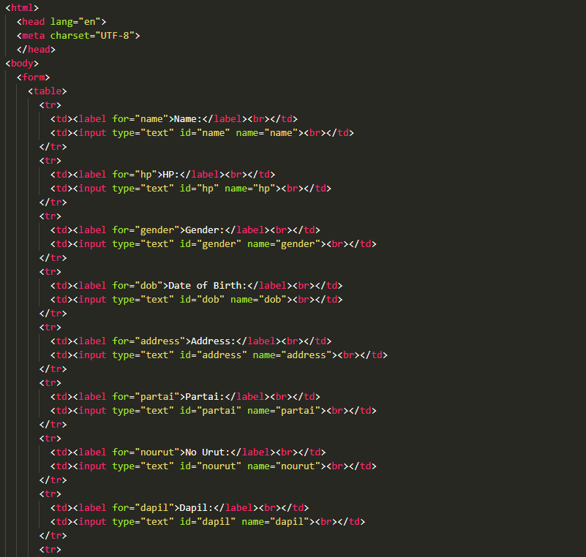
Source Code caleg.html

Slide 6
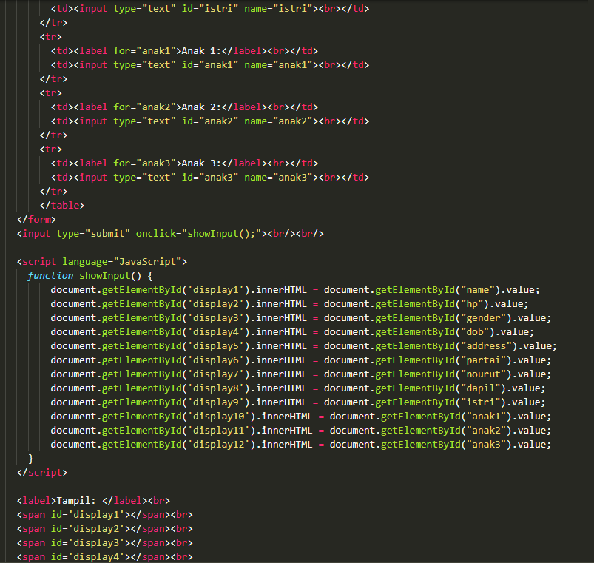
Source Code caleg.html

Slide 7
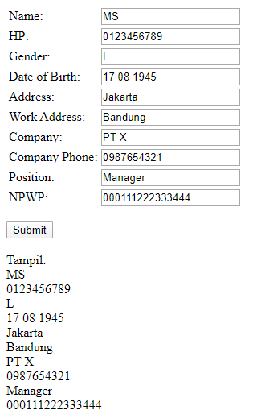
Pekerja

Slide 8
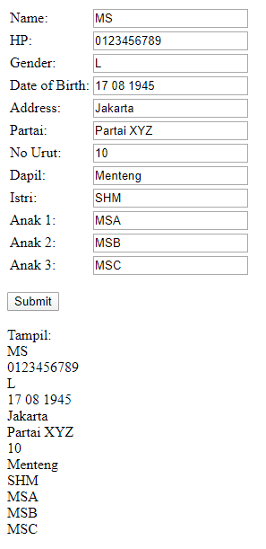
Caleg

Slide 9
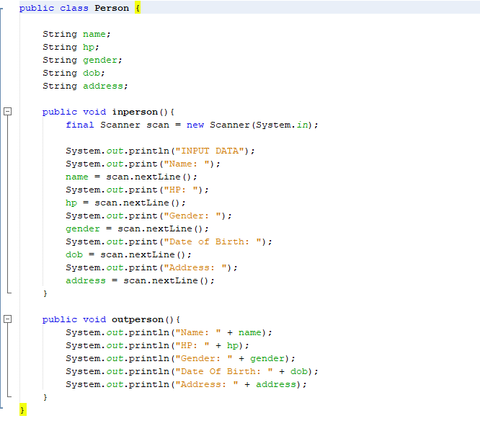
SourceCode Person.java

Slide 10
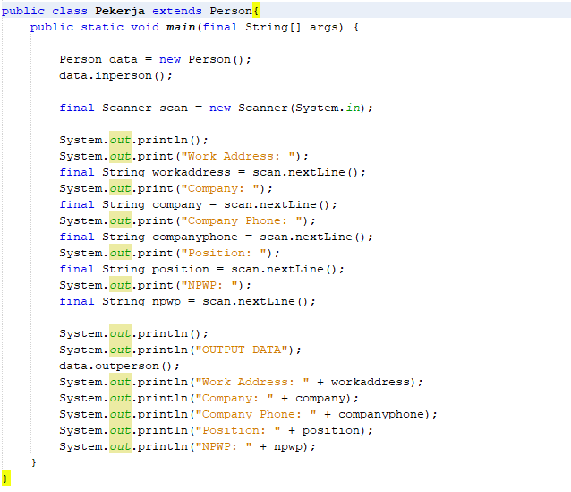
SourceCode Pekerja.java

Slide 11
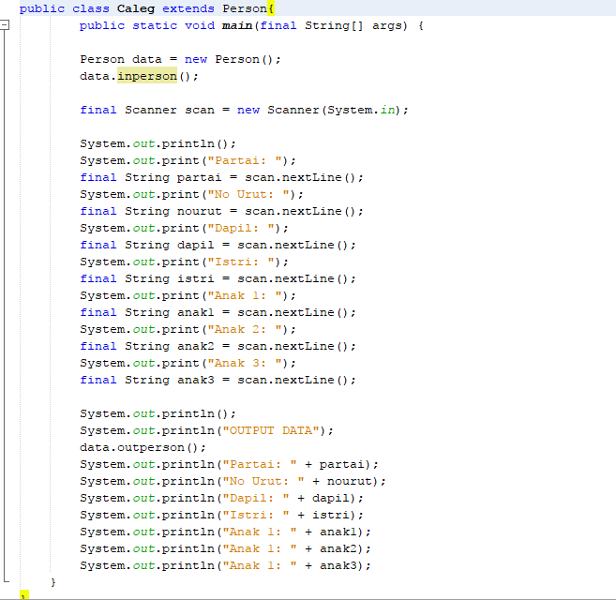
SourceCode Caleg.java

Slide 12
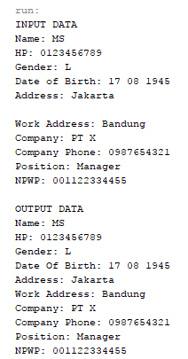
Pekerja

Slide 13
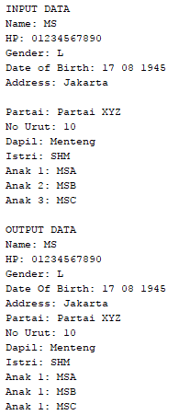
Caleg

